Slide 1
October 2025 Data Stewards Group
Virginia Office of Data Governance and Analytics
October 22nd, 2025

Slide 2
Agenda
Time | Topic
1:00-1:20 PM | Welcome and Opening Remarks, Roll Call, DSG Order of Business
1:20 PM-1:40 PM | Data Governance
1:40 PM-1:50 PM | Interagency Data Sharing
1:50 PM | Break
1:55 PM | Visualizations Best Practices
2:15-2:25 PM | ODGA Events/2026 quick discussion, Member and Public Comment, Adjourn

Slide 3
Data Stewards Group
Purpose
Implement data sharing and analytics projects promoting data accessibility, sharing, and reuse, thereby reducing redundancy across the Commonwealth.
Promote the collection and sharing of metadata by registering data assets in the Virginia Data Catalog
Ensure data quality processes and standards are implemented consistently by agencies in the Commonwealth
Provide the Board and Council with technical subject matter expertise in support of data policies, standards, and best practices.
Coordinate and resolve technical stewardship issues for standardized data.
Provide communication and education to data users on the appropriate use, sharing, and protection of the Commonwealth's data assets.
Liaise with agency project managers and information technology investment staff to ensure adherence to Commonwealth data standards and data sharing requirements.
Support informed, data-driven decision making through compliance with Commonwealth data policies, standards, and best practices.
Related legislation: https://lis.virginia.gov/cgi-bin/legp604.exe?212+ful+CHAP0314

Slide 4
Meeting Purpose
Share visualization best practices
Facilitate data sharing
Refine Charter and KPI’s
Improve compliance with GDCDPA

Slide 5
Order of Business
Approve Meeting Minutes
Data Stewards Group Charter Review
Approve new KPIs

Slide 6
Governance

Slide 7

What is the GDCDPA?
The Government Data Collection and Dissemination Practices Act (Code of Virginia § 2.2-3800 et seq.) is Virginia's comprehensive privacy law governing how state and local agencies handle personal information.
Why is ODGA offering this training?
§ 2.2-203.2:4 “The purpose of the Office shall be to (i) improve compliance with the Government Data Collection and Dissemination Practices Act (§ 2.2-3800 et seq.)”
Notes:
The act has been amended multiple times since its original 1976 codification, with various updates occurring in 1978, 1987, 1989, 2000, 2001, 2002, 2003, 2006, 2009, 2017, 2018, 2019, and 2020. It's currently codified as Chapter 38 of Title 2.2 of the Code of Virginia.
Why Does This Matter?
Sarah works for a state agency and receives a phone call asking for an employee's home address. Without knowing the GDCDPA, she might accidentally violate privacy laws. After this training, she'll know the proper procedures to follow.

Slide 8

Who and What are Covered by the Act
State Agencies
Local Government
Political subdivisions
Any system containing personal information about individuals
§ 2.2-3801. Definitions
Agency = agency, authority, board, department, division, commission, institution, bureau, or like governmental entity of the Commonwealth or of any unit of local government including counties, cities, towns, regional governments, and the departments thereof, and includes constitutional officers, except as otherwise expressly provided by law. "Agency" shall also include any entity, whether public or private, with which any of the foregoing has entered into a contractual relationship for the operation of a system of personal information to accomplish an agency function.
Including constitutional officers and contractors handling personal information

Slide 9
§ 2.2-3801 Collection and Sharing IS Allowed for “Proper Purpose”
Streamline administrative processes to improve the efficiency and efficacy of services, access to services, eligibility determinations for services, and service delivery
Reduce paperwork and administrative burdens on applicants for and recipients of public services
Improve the efficiency and efficacy of the management of public programs
Prevent fraud and improve auditing capabilities
Conduct outcomes-related research
Develop quantifiable data to aid in policy development and decision making to promote the most efficient and effective use of resources
Perform data analytics regarding any of the purposes set forth in this definition.
Notes:
#1 Example – Virginia Permit Transparency

Slide 10
Best Practices
Maintain current inventory of information systems
Train staff on GDCDPA requirements
Establish clear data subject access and correction procedures
Keep access logs
Review data sharing agreements
Implement appropriate security measures
Post internet privacy policies

Slide 11
Data Governance Award Winners
Large Agency
Medium Agency
DBHDS
VSP
TAX
DOE
TRS
Honorable Mention
DEQ and VDH

Slide 12
Fast Facts - Data Governance and Compliance
Open Data Portal
31,503 datasets
47,600 visits in Sep
New Agencies – TAX, TRS, VSP
512,796 assets
14,614 glossary terms
Unstructured Data Scanning
49.69M objects scanned
14 executive agencies scanned
85,602 page views
Structured Data Scanning
Data Classification
Sec 540 published
Data Classification Policy and Standard Available
Data Classification Framework ETA Nov 1
Sources Scanned - file shares, OneDrive, Sharepoint, Filenet

Slide 13
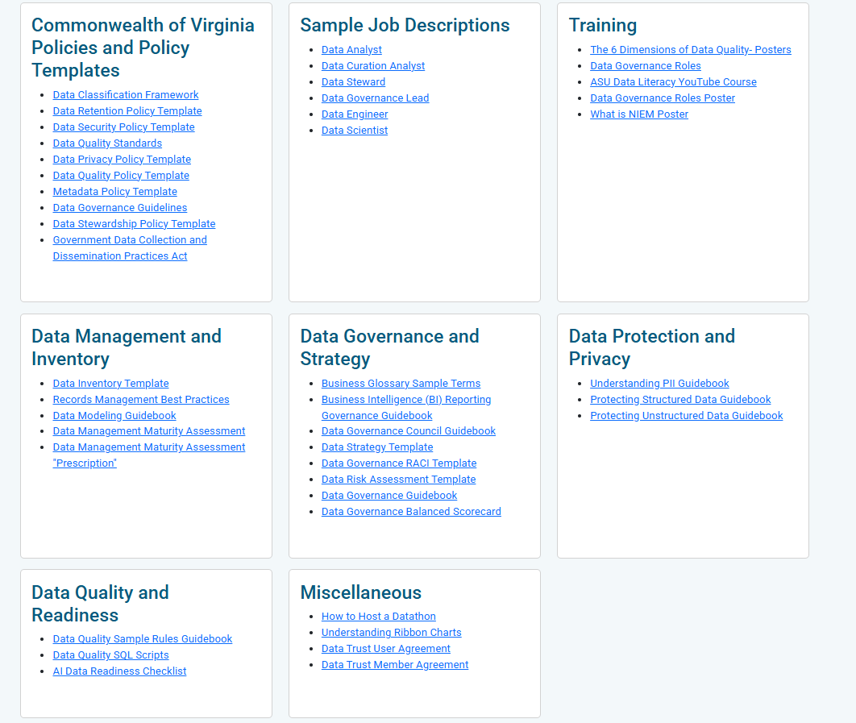
ODGA Data Governance Resources
New Resource Page Content
Guidebooks
Data Classification Framework
Data Management Maturity Assessment
Data Management Maturity Assessment Prescription

Slide 14
Lunch and Learn Stats
23 lunch and learns
774 attendees
51 agencies
2026 Lunch and Learn Schedule Coming Soon:
  Data Architecture
  Data Lineage and Lifecycle
  Data Modeling
  Data Strategy Workshop
  Power BI Basics
  Data Classification

Slide 15
2025 Dataversity Update
1000+ Classes Available
113 classes completed Jan-Sept 2025
70 classes started
Top 5 Learner Agencies
  DSS
  DEQ
  Tie: VDH and DOE
  Virginia 529
  VDEM
7 people started or completed at least 1 DMBoK certification course
Most Popular Classes
DG3: Data Governance Roles and Responsibilities (5)
DG6: Data Governance Best Practices (4)
DG1: Getting Started Governing Data – The Data Governance Framework (4)
AIAG: Agentic AI Governance (4)
DG2: Creating a Data Governance Operating Model (4)
DMBK3: Data Quality Management (4)
Last Year
What is Data Management? (15)
Getting Started Governing Data – The Data Governance Framework (14)
Creating a Data Governance Operating Model (10)
What is Data Governance? (10)
DG3: Data Governance Roles and Responsibilities (8)

Slide 16
Data Literacy
New Videos
Video Library
Data Literacy Foundations
Per Capita
How to Write an Executive Summary
Data Storytelling
Spotting Data Entry Errors
Sampling Methods
Bias in Data Collection
Credibility
Quantitative vs Qualitative
Structured and Unstructured Data
Mean, Median, Mode
Misleading Statistics
Polls and Margin of Error
Correlation vs Causation
Probability and Risk
Boolean Logic
You are the Product
Master the Language of Data Visualizations
Misleading Charts
Data Literacy Library
Available to all COV employees – no VCCC tickets required!
Localities and non-COV employees can request access from ODGA
Most popular videos highlighted in bold

Slide 17
Data Literacy Adoption
Group discussion

Slide 18
Interagency Data Sharing

Slide 19
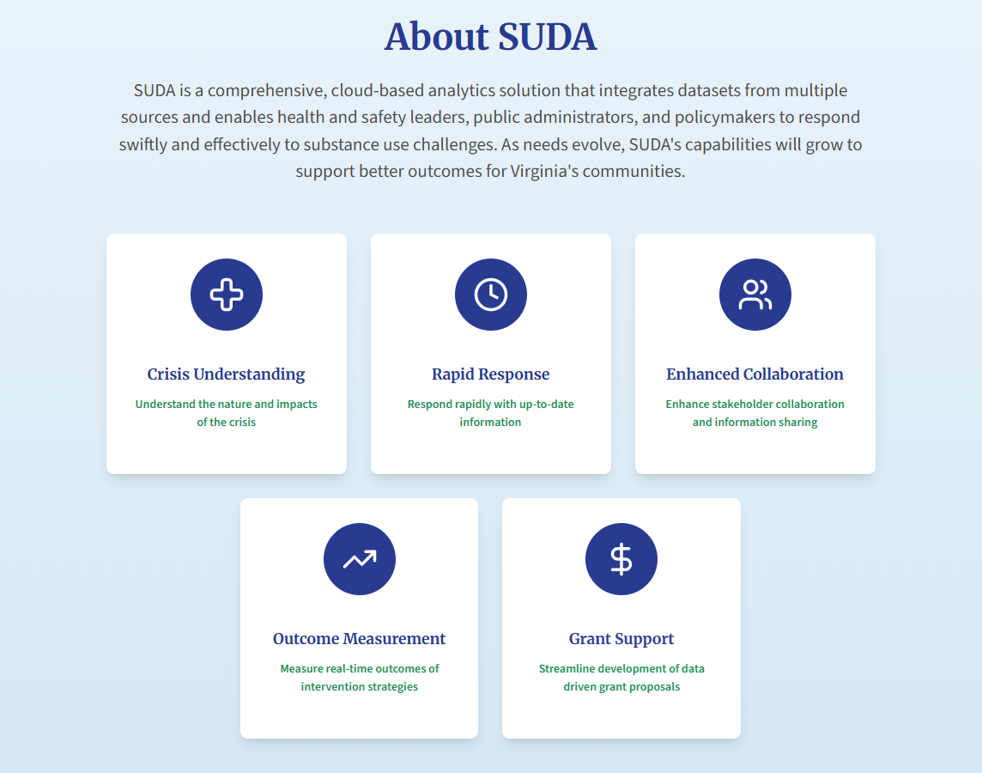
Substance Use Data Analytics

Slide 20
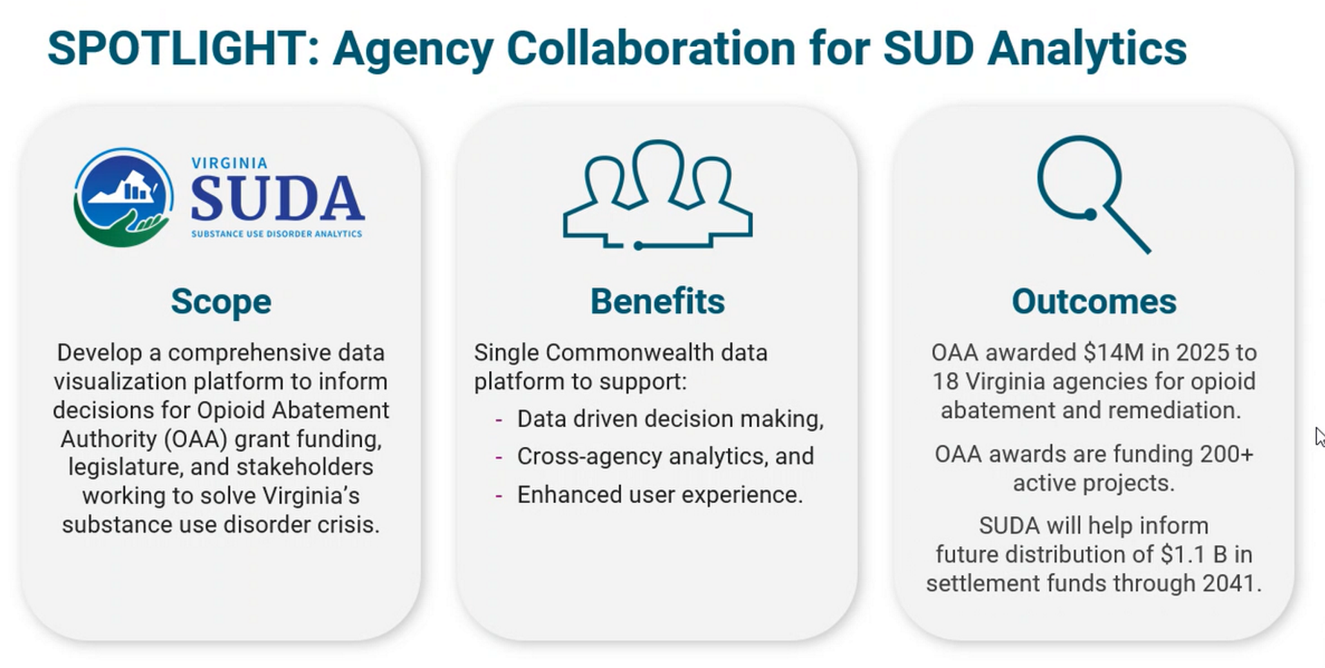
Substance Use Disorder Analytics pt 2

Slide 21
Tiered Approach to Control Access to SUDA Data
Tier 3 – Future Phases with Enhanced Restrictions
Tier 3
Restricted For Protected Data
Involves handling of restricted data such as CJIS, PCI, SSA, Law Enforcement. Used for analysis and summarization by ODGA. Visualizations and analysis required Data Owner permission before publishing. No access outside ODGA to underlying data
Tier 2 – Limited Use with Data Owner Permission
Increased Control
Tier 2
Restricted Access for Sensitive Datasets
Visualization with ability to drill down or access datasets with PII, PHI, PMI. Requires user authentication and authorization. Requires signed Commonwealth Data Trust (CDT) User Agreement approved by Data Owner. Appropriate security controls and role-based access.
VITA/ODGA works with data owners to implement appropriate restrictions for each data element.
Tier 1 – Majority of Use
Tier 1
Limited Access for Summarized Insights
Available as a visualization with summarized or non-PII data. Submit a formal access request that VOAA will approve, and users sign an NDA. Requires user authentication and authorization.
Tier 0
Public Data
Tier 0 – Open Data Portal
Public data (e.g. Open Data Portal data, US census data) used for SUDA analysis.
Additional Data Governance Protections:
Data elements within the platform will be classified based on their sensitivity level (e.g., public, confidential, highly confidential). Reports will inherit the highest sensitivity level of the data they contain.
Reports will be designed to aggregate data where possible
All access to sensitive reports will be logged and regularly audited.

Slide 22
Next Steps
Refine Charter and KPI’s
Share visualization best practices
Improve compliance with GDCDPA
Facilitate data sharing

Slide 23
Visualizations Best Practices
Payton Lamb, ODGA Data Architect

Slide 24
Seven Critical Design Mistakes
Fails At-a-Glance View
  The dashboard extends beyond a single screen, requiring scrolling and disrupting flow.
Misaligned Elements
  Visual elements like gauges and KPI cards create an inconsistent, unprofessional layout.
Unnecessary Information
  Includes irrelevant images and repetitive data that distract from key insights.
Doesn't Start from Zero
  Gauge visualizations distort data perception and can potentially mislead viewers.

Slide 25
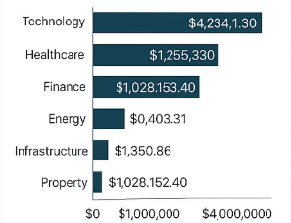
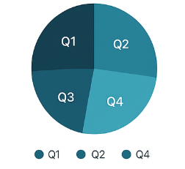
Seven Critical Design Mistakes pt 2
Lengthy Data Labels
  Data labels are too long with unnecessary decimal points, reducing clarity and readability.
Unclear Visuals
  Overcrowded charts without legends leave users guessing what segments represent.

Slide 26
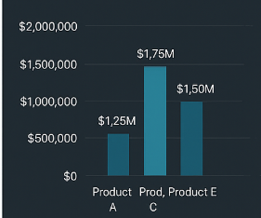
Seven Critical Design Mistakes pt 3
Poor Color Choices
  Dark backgrounds with inappropriate color schemes reduce visual appeal and readability.

Slide 27

Foundation: Know Your Audience
Understanding User Needs
  Before diving into design, understand who will use your dashboard. Consider their data literacy level and specific information needs.
  Tailor visualizations to user expertise
  Focus on relevant metrics
  Avoid information overload

Slide 28
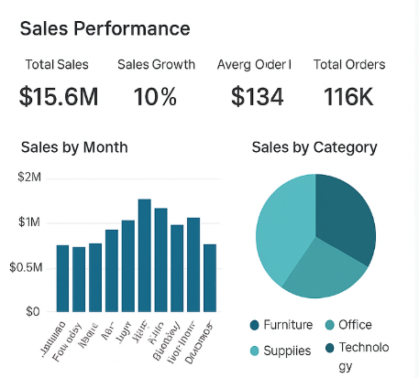
Design Principles for Success
Eliminate Unnecessary Information
  Remove elements that don't add value. Replace duplicate data with meaningful metrics to declutter and focus attention.
Keep Typography Simple
  Avoid bold, italic, or exaggerated fonts. Stick to clean, readable typography for professional design.
At-a-Glance Design
  Display all essential information within a single screen for quick insight and comprehension, minimizing the need for scrolling.

Slide 29

Choose the Right Visualizations
Bar & Column Charts
  Ideal for comparing categories or tracking changes over time.
Line Charts
  Great for illustrating trends and patterns in data.
Pie Charts
  Best for showing proportions, but limit to 6-7 categories for readability.

Slide 30

Visual Alignment & Consistency
Create Visual Hierarchy
Leverage Whitespace
Maintain Consistency
Utilize whitespace effectively to balance layout, enhance clarity, and prevent overcrowding.
Use uniform colors, fonts, and styling throughout for cohesive, professional appearance.
Use size, color, and positioning to direct users' focus to most important information first.

Slide 31
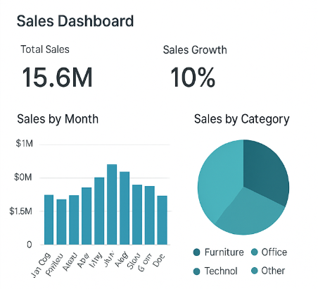
Technical Best Practices
Start from Zero
  Always start visualizations from zero on the y-axis for accurate data representation.
Simplify Data Labels
  Keep labels concise with short descriptions and minimal decimal points.
Color Selection
  Choose lighter backgrounds for readability and create contrast with visual elements.
Tell a Story
  Structure dashboards to guide users from high-level overviews to detailed insights.

Slide 32

Transform Your Dashboards
Designing effective Power BI dashboards involves thoughtful planning and attention to detail. By applying these best practices, you can create dashboards that deliver valuable insights and empower data-driven decisions.
Focus on user needs and maintain a commitment to clear, impactful design to transform your dashboards into powerful business tools.

Slide 33
Events
Recent
Lunch and Learns: Visualizations Best Practices, Data for Executives, Data Risks and Issues
Upcoming
DMMA Moved to 2026!
Lunch and Learns: Understanding the Virginia Data Collection and Dissemination Practices Act
On the Square: Oct 29 “Demystifying Data with ODGA”

Slide 34
2026 Planning: How Can We Help?
What do you want from ODGA?
Data Visualizations
Data Governance Assistance
Lunch and Learns
Training/Education
More!

Slide 35
Questions?

