Slide 1
Data Governance Council Meeting
June 23, 2026
Virginia Office of Data Governance and Analytics

Slide 2
Agenda
Agenda item | Facilitator | Content
1:00 PM: Welcome and Order of Business | Marcus Thornton, ODGA | Data Governance Council Order of Business
1:15 PM: ODGA Announcements | Marcus Thornton, ODGA, Jessi Bailey, ODGA | Updates from the Office of Data Governance and Analytics
1:25 PM: EA 225 | Chris Burroughs, ODGA, and Stephen Smith, VITA | Updates to the EA 225 for agencies
2:00 PM Break | Break | Break
2:05 PM: Reference Data and Master Data | Chris Burroughs, ODGA | Introduction to new project for data governance
2:35 PM: Virginia Government Data Collection and Dissemination Practices Act | Chris Burroughs, ODGA | Updates to the act that affect agencies
2:45 PM: Upcoming Events | Jessi Bailey | Upcoming items for the Office of Data Governance and Analytics
2:50 PM: Member and Public Comment, Adjourn | Marcus Thornton, ODGA

Slide 3
Data Governance Council
Purpose
Advise the CDO on data technology, policy, and governance structure.
Administer data governance policies, standards, and best practices, as set by the Board.
Oversee data sharing and analytics projects.
Liaise between state agency operations and the CDO
Review open data assets prior to publication.
Provide to the Board any reports on the Council's recommendations and work as required by the Board.
Develop necessary privacy and ethical standards and policies for Commonwealth Data Trust resources.
Monitor the sharing of Commonwealth Data Trust member-contributed data resources.
Review and approve new Commonwealth Data Trust-managed data resources.
Conduct any other business the CDO deems necessary for Commonwealth Data Trust governance.
Related legislation: https://lis.virginia.gov/cgibin/legp604.exe?212+ful+CHAP0314

Slide 4
Meeting Purpose
Improve Open Data Engagement
Prioritize reference datasets
Introduce EA-225 Requirements
Improve government efficiency

Slide 5
Order of Business
Approve Meeting Minutes

Slide 6
Announcements
ODGA INITIATIVES
COMMUNITY & EXTERNAL EVENTS
Expansion of Data Governance Council
Affordability Dashboard
Dataversity Renewal
Datathon
SUDA Enhancements
RVA Data Enthusiasts — July 1
DAMA RVA — July 10
AI Ready RVA Government Cohort — July 28

Slide 7
2026 Datathon COMING SOON
October 8-16, 2026
Brightpoint Community College
This year's theme: Beyond the Numbers: Building an Affordable Virginia
Event open to college students and state employees and their contractors
Amazon gift card prizes!
Participants asked to assess affordability based on one or more of the following topics:
  Housing
  Energy
  Healthcare
  Childcare
  Education
  Living Expenses

Slide 8
Top 10 Most Popular Open Data Portal Pages
Fishing & Hunting License Sales 2020
Community Policing Data
Virginia State Police Cold Case Data
National Pipeline Mapping System
Free Negro Registers
AADT 2024 Fairfax
Delinquent Property Taxes (Norfolk)
Police Incident Reports (Norfolk)
VDH EMS Substance Use Response Incident Patients
Promethazine hydrochloride

Slide 9
EA-225 Information Standard

Slide 10





Why Strong Data Governance Matters
PURPOSE & SCOPE
EA-225 applies to ALL Commonwealth agencies that manage, develop, purchase, or use IT resources.
Better Decisions
Foundation for AI
Reliable, accurate data enables informed policy and targeted resource allocation.
Strong governance underpins analytics, AI, and predictive modeling at scale.
Federal Alignment
Privacy & Trust
Meet federal reporting standards to maintain program funding and compliance.
Consistent data practices protect residents and reinforce public trust.
Better Services
Efficiency & Savings
High-quality data enables tailored, faster services for Virginia residents.
Standardized practices reduce redundancy and mitigate costly data risks.
Excludes: Research projects, research initiatives, and instructional programs at public institutions of higher education.

Slide 11
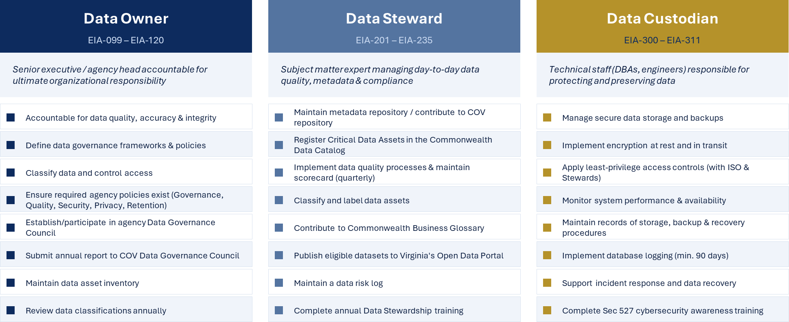
Data Governance Roles
DATA GOVERNANCE ROLES
Three Functional Roles Every Agency Must Identify

Slide 12
Data Classification and Protection (Sec 540)
CLASSIFICATION LABELS
KEY REGULATORY LABELS
Public
PII
Personally Identifiable Information
PMI
Personal Medical Information
Freely available; no restrictions. Open data portals, websites.
PHI
Protected Health Information (HIPAA)
FERPA
Family Educational Rights & Privacy
Internal Use Only
State personnel & approved affiliates. Requires authentication & usage monitoring.
FTI
Federal Tax Information
PCI
Payment Card Information
Personal
Non-COV-operations staff data. Commonwealth retains right to access/disclose.
CI
Critical Infrastructure
LE
Law Enforcement Data
Confidential
Authorized individuals only. Requires access logs, documented sharing, approved storage.
SENSITIVITY LABELS (applied after classification)
AI Training Data
Sensitive – Confidential
Protected from unauthorized access
Data approved for AI/ML model training. Data Owner must document approval.
Sensitive – Integrity
Protected from unauthorized modification
Sensitive – Availability
RTO ≤ 8 hrs / RPO ≤ 4 hrs

Slide 13
Managing Metadata Across Every Agency
METADATA REQUIREMENTS
COV METADATA REPOSITORY (EIA-400–406)
REQUIRED METADATA ELEMENTS PER DATASET (EIA-405)
Established by ODGA
1
Dataset Name & Description
Central repository accessible to all authorized COV users (EIA-400/401).
2
Classification Levels
Agency Repositories
Agencies with their own repo must export and share with ODGA (EIA-402).
3
Data Owner & Data Steward
Critical Data Assets
4
Data Source / Origin
Captures quality, format, lineage, structure, and access controls for all critical assets (EIA-403).
5
Frequency of Updates
Standardized Taxonomy
Uses the COV Data Taxonomy (Appendix III) for consistent representation across agencies (EIA-404).
6
Retention Periods
ODGA Maintenance Process
7
Quality Level Metrics
ODGA maintains processes for ongoing updates to the repository (EIA-406).
Metadata stewardship is an ongoing responsibility — not a one-time exercise.

Slide 14
Quality Standards, Tiers & Agency Obligations
DATA QUALITY MANAGEMENT
7 DATA QUALITY PROPERTIES (EIA-501)
AGENCY OBLIGATIONS (EIA-503–508)
Accuracy
EIA-503
Data represents reality correctly
Identify and report data quality issues through data discovery; address issues over time.
Completeness
All required data is present
EIA-504
Consistency
Set specific quality metrics and targets for Critical Data Assets (e.g., ≥95% accuracy / Tier 1 or 2).
No discrepancies across systems
EIA-505
Relevancy
Data Stewards maintain and improve quality of Critical Data Assets on an ongoing basis.
Data is fit for its intended use
Validity
EIA-506
Conforms to format/range/pattern
Follow standard processes for assessing, maintaining, and reporting quality for operations and planning.
Timeliness
Data is current and up to date
EIA-507
Uniformity
Use data lineage tracking tools to record origin, transformations, and destination for all datasets.
Consistent representation across datasets
EIA-508
Evaluate all assets against quality tiers and record results in the metadata repository.

Slide 15

What Do You Need to Do?
What Every Agency Must Do
Category | Description
Designate Roles | Appoint a Data Owner, Data Steward(s), and Data Custodian(s) for each data domain.
Establish Governance | Form an agency Data Governance Council sized to agency (small/medium/large) per EIA-702.
Create Required Policies | Publish and maintain 7 policies: Governance, Metadata, Quality, Security, Privacy, Retention, Stewardship.
Inventory & Classify Data | Inventory all data assets, apply classification + sensitivity labels, and review annually.
Register assets in COV Data Catalog | Register all datasets in the Commonwealth Data Catalog; register Critical Data Assets in the metadata repository.
Implement Data Quality | Assign quality tiers (I–IV) to Critical Data Assets; document baselines and track metrics in scorecards
Apply Protection Controls | Encrypt PII/PHI at rest and in transit; enforce least-privilege; enable 90-day database logging
Report Annually | Submit annual report to COV Data Governance Council: scorecard, incidents, privacy attestation, risk log
Complete Training | Data Owners/Custodians: Sec 527 training. Data Stewards: annual stewardship training. All staff: data literacy
Request Exceptions Proactively | File EA exception requests BEFORE developing, procuring, or deploying non-compliant technology.

Slide 16
Reference and Master Data

Slide 17
Current State
Data Inconsistency
Duplicated Effort
Same data such as companies or buildings are recorded with different names, addresses, and identifiers across agencies
Each agency independently researches and maintains reference data, wasting resources
Limited Interoperability
Compliance Risk
No common identifiers or formats, making data sharing difficult and error-prone
Inconsistent data hinders accurate reporting and creates regulatory compliance gaps

Slide 18


Two Core Concepts in Data Governance
Master Data Management
Reference Data
What it is:
What it is:
A program to create and maintain a single, authoritative version of an agency's most critical data entities — so everyone is working from the same source of truth.
Standardized sets of allowable values used to classify, categorize, or decode other data — ensuring consistent meaning across systems and agencies.
vs.
Virginia Government Examples:
Virginia Government Examples:
Citizen: One record per resident, shared across DMV, DMAS, VEC
County Codes: FIPS codes for all Virginia localities
Agency: Authoritative list of all Commonwealth agencies & sub-units
Program Codes: Standardized budget program identifiers
Employee: Single employee record used by DHRM, payroll, and benefits
Race/Ethnicity: OMB-aligned categories used statewide
Vendor: One vendor ID used across procurement and payments
Incident Types: Uniform crime classification codes for law enforcement

Slide 19
How They Work Together: A Real-World Example
📋 Scenario: A Virginia resident applies for a benefit program through two different state agencies.
WITHOUT
MDM or Ref. Data
WITH
Reference Data
WITH
MDM + Ref. Data
DMV and DMAS each store 'John Smith' differently
Race/ethnicity always stored as standard OMB code '2054-5'
One golden record per resident, linked across DMV and DMAS
Race/ethnicity coded as 'W', 'White', and '1' across systems
County always stored as FIPS code '51013'
Consistent codes mean data can be joined and compared
Duplicate records, conflicting data, broken eligibility checks
All agencies speak the same vocabulary
Eligibility determined once — no manual reconciliation
💡 Key Takeaway: Reference Data standardizes what values mean. MDM standardizes which record to trust. Together, they make data interoperable across agencies.

Slide 20
Program Benefits
Operational Efficiency
Data Quality
Reduce data collection and maintenance effort
Accelerate system development timelines
Single source of truth from authoritative systems
Greater accuracy and timeliness
Consistent reporting and analytics
Interoperability
Strategic Foundation
Common identifiers across agencies
Seamless data integration
Enhanced cross-agency collaboration
Scalable platform for additional domains
Governance framework in place
Pathway to citizen MDM

Slide 21
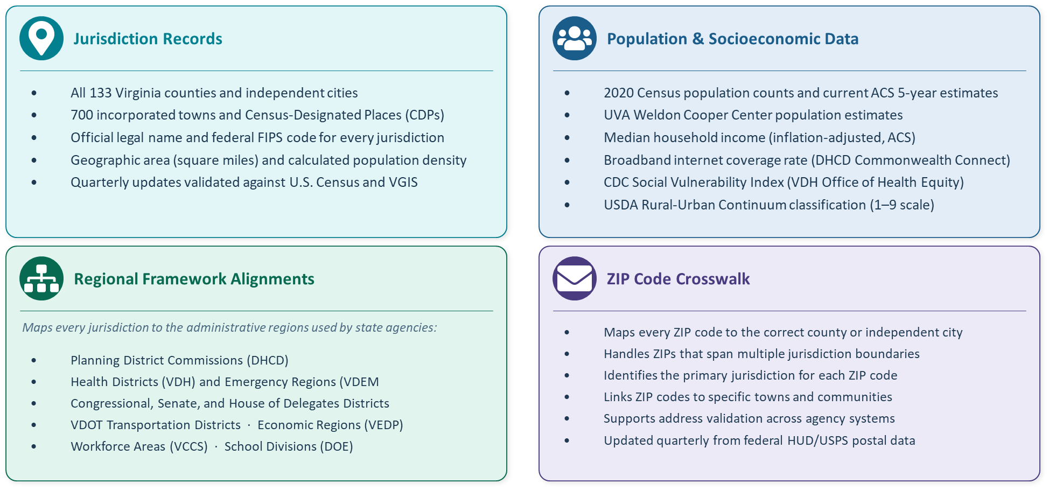
Jurisdiction Reference Data: What's Included
Sources: U.S. Census Bureau · UVA Weldon Cooper Center · VDH · DHCD · USDA ERS · Dept. of Elections · VDEM · VDOT · VEDP · HUD/USPS · VGIN
Notes:
KEY TALKING POINTS FOR COUNCIL:
This slide describes what's in the Virginia Jurisdiction Reference Data Model — now published in the IDMC Data Marketplace by ODGA.
What problem does it solve? Every agency maintains its own list of Virginia counties and cities — different formats, different codes, different regional groupings. This model is a single authoritative source that any agency can reference instead of maintaining their own.
FOUR SECTIONS:
1. JURISDICTION RECORDS (323 total): Every county, city, town, and census-designated place in Virginia. Each has its official legal name and a unique federal FIPS code — think of it like a Social Security number for each jurisdiction.
2. POPULATION & SOCIOECONOMICS (10+ indicators): Population from three sources (Census, ACS estimates, Weldon Cooper projections), plus income, broadband access, and the Social Vulnerability Index. Agencies doing grant applications or resource planning can pull from this directly.
3. REGIONAL FRAMEWORK ALIGNMENTS (9 frameworks): The hardest thing for agencies to maintain on their own. Each jurisdiction is already mapped to planning districts, health districts, legislative districts, transportation districts, emergency management regions, workforce areas, and school divisions — so cross-agency reporting and aggregation is straightforward.
4. ZIP CODE CROSSWALK (900 records): Maps ZIP codes to jurisdictions, accounting for ZIPs that cross county lines — a common data quality problem in agency systems that collect addresses.
All of this is available now in the Marketplace, with quarterly updates maintained by ODGA.

Slide 22
Data Marketplace
Demo

Slide 23
Potential Non-Citizen Data Domains
Geographic & Location Data
Counties and jurisdictions
ZIP codes and postal addresses
Census tracts and voting districts
State parks and public lands
Road segments and transportation networks
Emergency service zones
Organizational Data
State agencies and departments (official names, codes, hierarchies)
Local government entities (cities, towns, counties)
Educational institutions (K-12 schools, colleges, universities)
Healthcare facilities and providers
Non-profit organizations receiving state funding
Financial & Procurement
Vendors and contractors doing business with the state
Chart of accounts codes
Budget categories and fund codes
Procurement codes and commodity classifications
Asset Management
Infrastructure assets (bridges, roads, utilities)
Public facilities and amenities
State-owned vehicles and equipment
Human Resources
Job classifications and position codes
Organizational units and cost centers
Regulatory & Licensing
Professional licenses and certifications
Permit types and classifications
Regulatory codes and standards
Program eligibility codes
National/State Standards
FIPS codes (Federal Information Processing Standards)
NAICS codes (industry classifications)
Uniform crime classification codes
Paid Services
Address verification
Email Verification
Phone verification
What are the Top 3 Domains you would like?
Notes:
Vote on next 3

Slide 24



Sharing Agency Data Assets
Connect
Approve
02
Deliver
Link Agency Data Assets
Manage Workflow Approvals
sFTP or API Transmission
Register datasets from any agency source in the Marketplace catalog. No data movement required — link directly to the source.
Route access requests through automated or manual approval workflows with configurable rules, roles, and notifications.
Push approved datasets to consumers automatically on a schedule or on-demand via secure sFTP transfers or API integration.
FOR DATA SUPPLIERS
FOR DATA CONSUMERS
Centralized catalog visibility for all published data assets
Controlled, auditable access through configurable approval workflows
Automated data delivery eliminates manual transfer effort
Immutable audit trail of all access requests and delivery events
Significant reduction in ad hoc, email-based data sharing requests
Self-service discovery of available data assets across agencies
Streamlined, trackable data access request and approval process
Flexible delivery via sFTP push or API pull to fit existing workflows
Consistent, reliable data access with reduced lead time
Single access point to datasets from multiple agency sources
Notes:
KEY TALKING POINTS:
The Data Marketplace goes beyond hosting ODGA's reference data — it's a full platform for inter-agency data sharing.
Three core capabilities:
• CONNECT: Agencies register and link their data assets to the Marketplace catalog. The data stays in the source system — the Marketplace just provides the catalog entry and delivery pipeline.
• APPROVE: When a consumer requests access, the system routes the request through a configurable approval workflow. This can be fully automated (e.g., approved for any state agency) or require manual review by the data owner.
• DELIVER: Once approved, IDMC can push the data via sFTP on a schedule or on-demand, or expose it through an API for real-time consumption. No custom integration work required from the supplier.
Benefits to emphasize:
• For suppliers: eliminates the ad hoc 'can you send me that file?' requests. Everything goes through the Marketplace with full audit trail.
• For consumers: no more chasing down data owners. Self-service discovery and a defined request process with consistent delivery.

Slide 25
Virginia Government Data Collection and Dissemination Practices Act
GDCDPA

Slide 26
What is the GDCDPA?
Origin & Purpose
Enacted in 1976
(1987) Act reorganized and moved within Code of Virginia
(2004) Codified at Virginia Code § 2.2-3800 et seq.
HB 1277 (2018) Amended 'proper purpose' to explicitly authorize inter-agency and Commonwealth–locality data sharing
HB 1161 (2026) Restricts dissemination to six grounds; expands definition of personal information
Governs how state agencies and political subdivisions collect, maintain, use, and disseminate personal information
Predates and complements the Virginia Freedom of Information Act (FOIA)
Applies to the Commonwealth, its agencies, and all political subdivisions
Individual privacy is directly affected by collection, maintenance, use, and dissemination of personal information
Increasing use of technology magnifies potential harm from these practices
Misuse endangers employment, insurance, credit, due process, and legal protections
Legislation is necessary to govern information systems containing records on individuals
Notes:
The GDCDPA is Virginia's foundational personal information privacy law for government agencies. It has been in place for nearly 50 years and sets the baseline rules for how agencies handle personal data. Unlike the VCDPA which governs private sector, the GDCDPA governs the government side.

Slide 27
Key Changes
Feature | Old Version | New Version (HB1161)
Definitions of Personal Info | Includes SSN, driver's license, and basic bio-characteristics (finger/voice prints). | Adds USCIS alien registration numbers, immigration status, faceprints, eye retinas, and digital photographs/video/audio.
Restrictions |  | Adds a general ban on selling personal information.
Consent Definition | Permission | Consent - Clear affirmative act signifying freely given, specific, informed, and unambiguous agreement.
Dissemination Rules | Broad authority to disseminate to accomplish a "proper purpose." | Limits dissemination to six specific scenarios, such as legal compliance, state/federal program administration, or explicit data subject consent.
Civil Penalties (Willful) | $250 to $1,000 for first violation by an officer or agency. | Increases individual penalties to $500 to $2,500 for certain violations, while maintaining original agency caps.

Slide 28
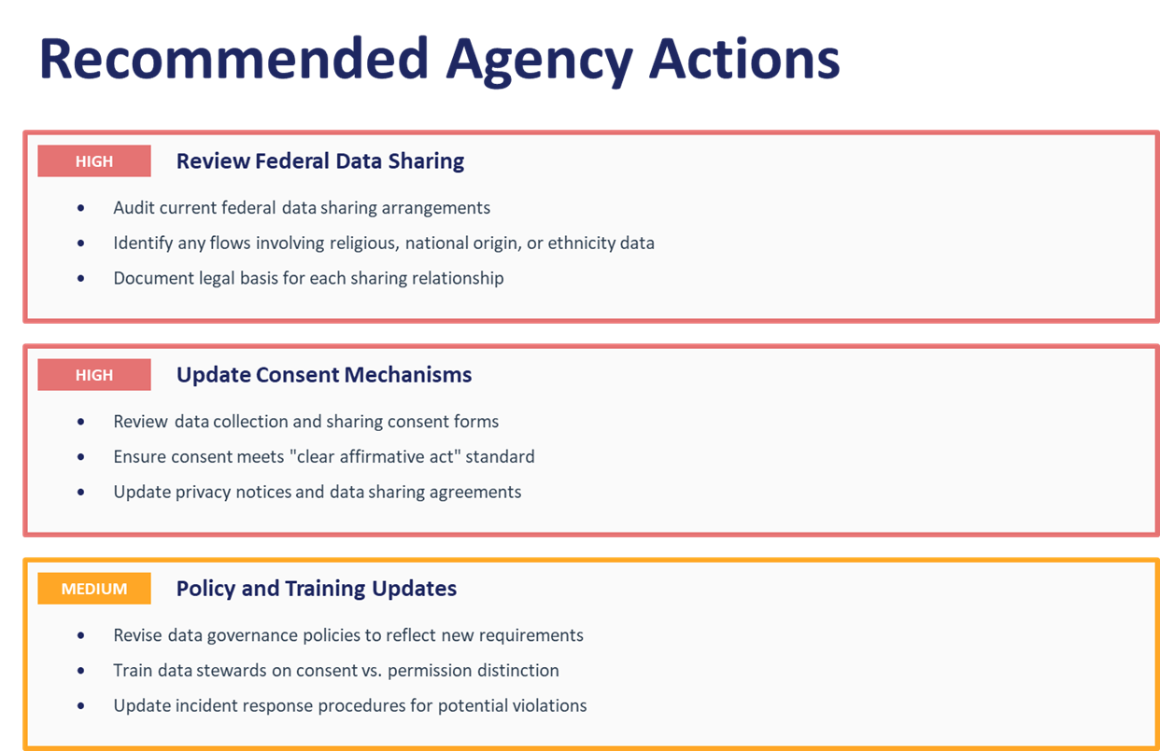
Recommended Agency Actions

Slide 29
ODGA Events
Recent
Upcoming
Virginia Datathon
Lunch and Learns: Data Architecture (Exploring Azure), Accelerating Data Governance with Gen AI, Data Strategy Workshop, Power BI Basics Part 2, Data Steward Training, Updates to the GDCDPA Act, Data Governance for Localities
Upcoming Lunch and Learns: Data Risks and Issues, Virginia Open Data Portal Workshop
Executive Data Board: Oct 14th
Data Governance Council: Nov 5th
Executive Data Board
Data Stewards Group: August 12

Slide 30
Questions?

